Slide 1

World Happiness Report, a broad overview.
Presented By:
Patrick Mayer
Tipu Sultan
Ujjwal Samanta

Slide 2
About Dataset:
The data is about world Happiness index of the world.
The data is available from the year 2007 to 2021.
In the initial year, only 24 nations happiness index were reported.
As the year Progressed, almost 150 countries data now available
There are various attributes are available like Happiness index score, confidence in the government, perception of corruption, how positive and negative attitude affect the nation etc.

Slide 3
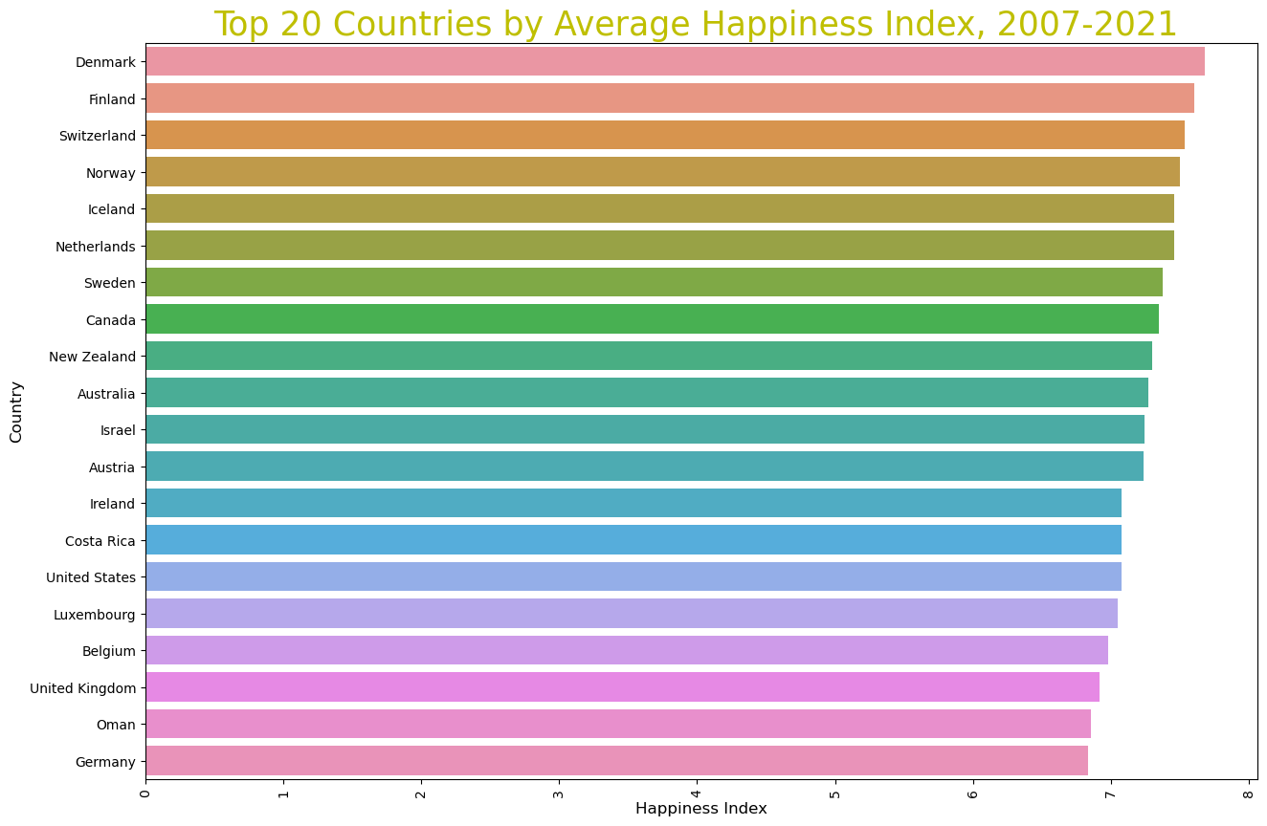
Why we Selected Denmark?
This plot tell us, top 20 countries who have cumulatively higher happiness index over the years.
Denmark is the country whose happiness index is comparative higher amongst all countries in the world.

Slide 4
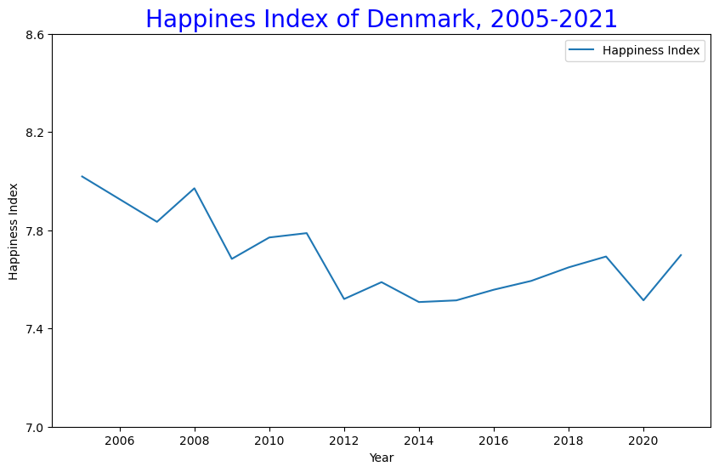
Time Series Graph of Denmark
Happiness Index vs Year
Year 2005 was the only year where Denmark happiness index higher amongst all the year, which was almost 8.
As year progressed happiness scores dipped from 8 to 7.8.
Lowest score found in the year 2012 and 2014.

Slide 5
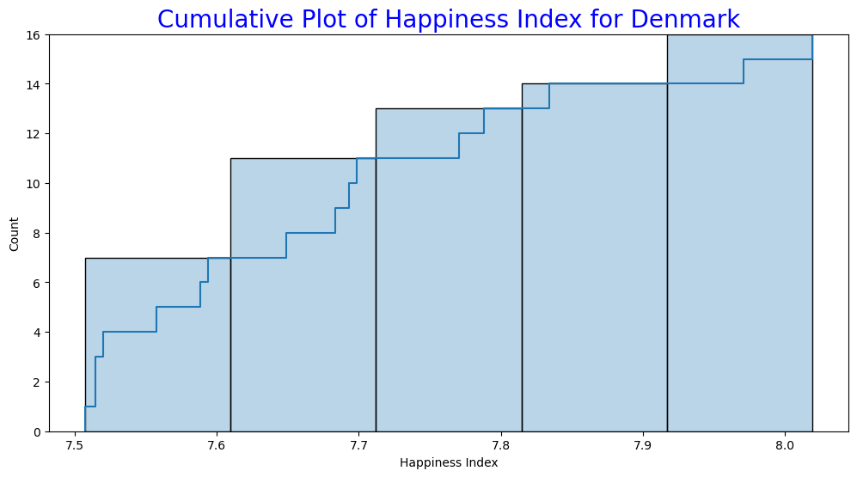
Cumulative Plot
Denmark maintained almost 7.5 to 7.7 happiness score throughout the years.
Between the range of 7.5-7.6, Denmark’s happiness index occurred most of the times, which is 6.5 times.
There was only one time where Denmark manage to score over 8.

Slide 6
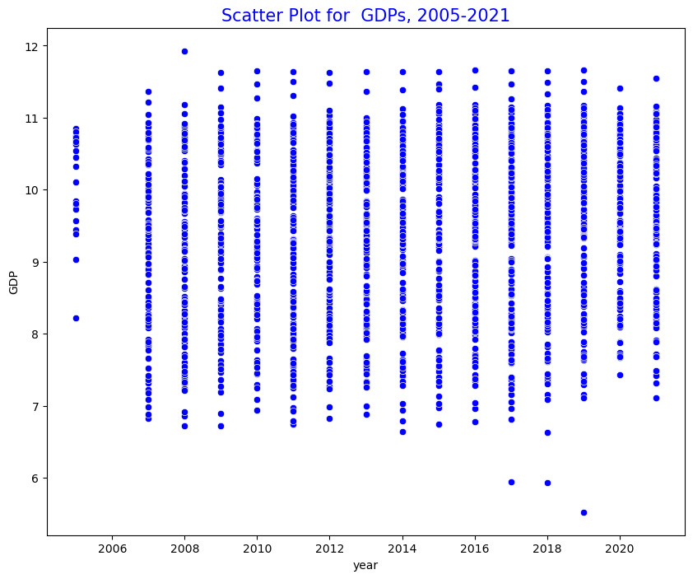
Scatter plot
GDP vs Over the Years
In the initial year only few countries data was included. Therefore, few countries are showing on the graph.
From 2007, the GDP is lies between 7 to 12 of every country.
Year 2008 was the only country where GDP of one country is about 12.
When more countries were added then got to know that there were few countries whose GDP was below 7 from the year 2016 to 2017.

Slide 7
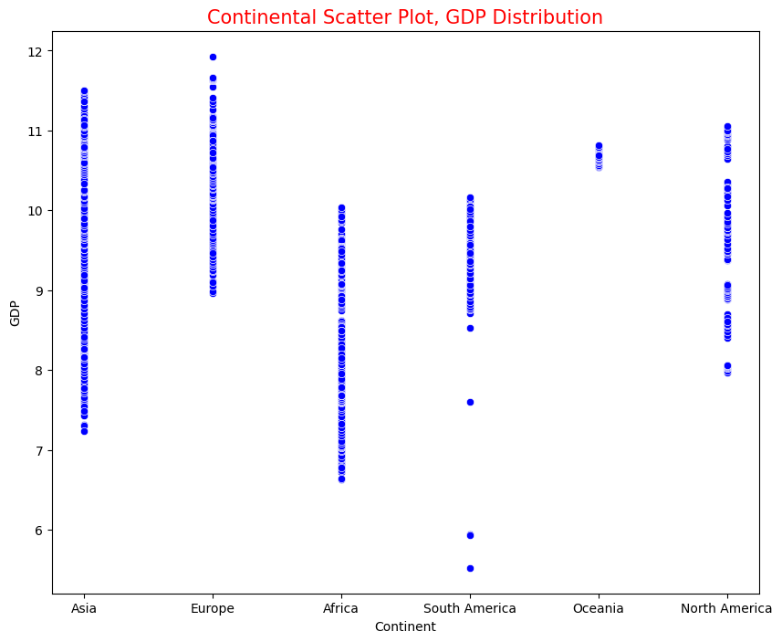
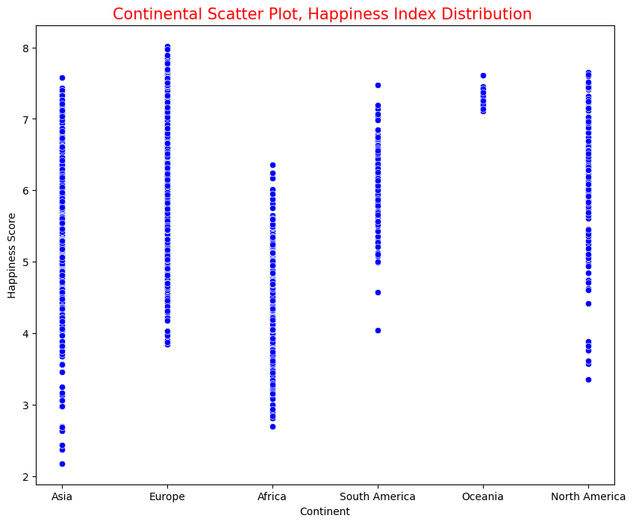
Scatter Plot
GDP, Happiness Index vs Continent
Europe has the best (between 9 to 12) GDP amongst all the continent this because mostly all countries in Europe are developed.
Few countries in the Oceania but GDP is also in the top.
There are few countries in the south America whose GDP is below 6.

Slide 8
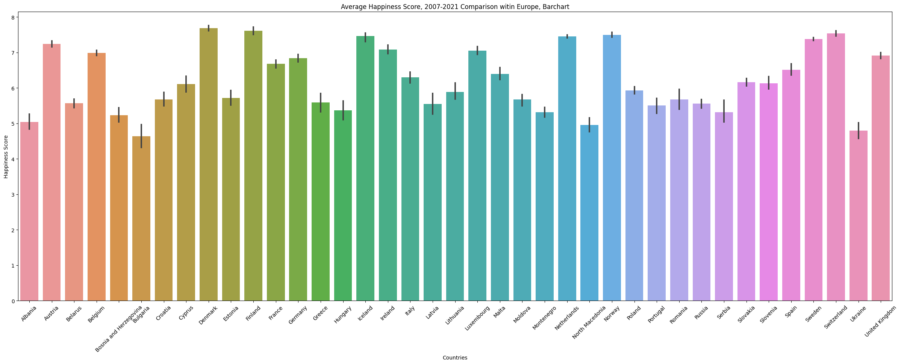
Barchart
European countries vs Happiness score
In the continent of Europe, Ukraine and Netherlands had the lowest happiness index.
Almost all the countries in the Europe has happiness index more than 5.
Countries like Denmark, Finland, Netherlands and Norway has almost highest happiness score amongst all countries in Europe.

Slide 9
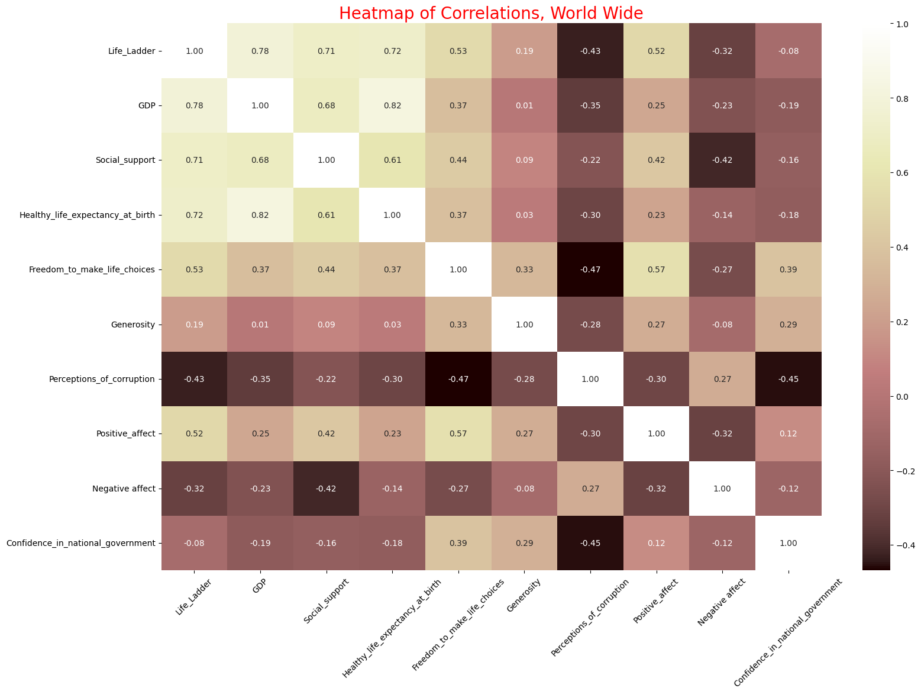
Heatmap
Correlation between all factors
Brighter colors have higher correlation
Top left quadrant is brightest
Happiness, GDP, Social Support, Healthy Life Expectancy strongest indicators of happiness

Slide 10
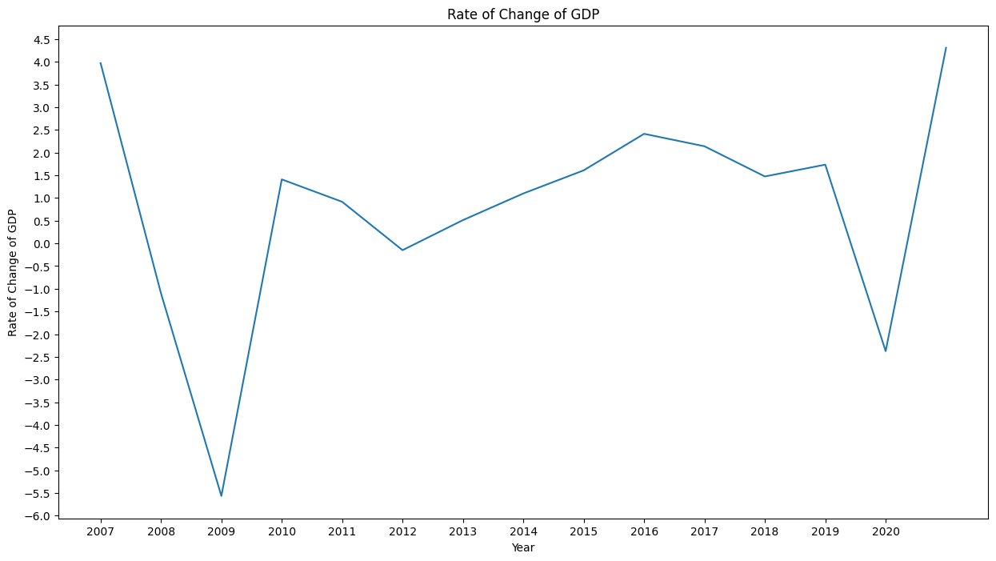
Rate of Change
Dips in 2009 and 2020 match that of Happiness Index
Happiness did not grow again until 2015, whereas GDP stabilized after 2012 (until 2019)

Slide 11
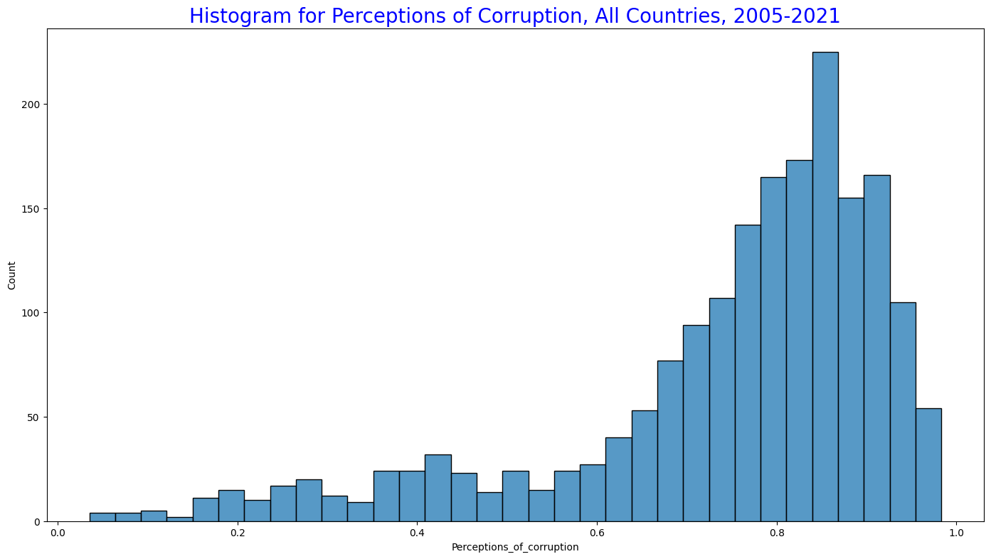
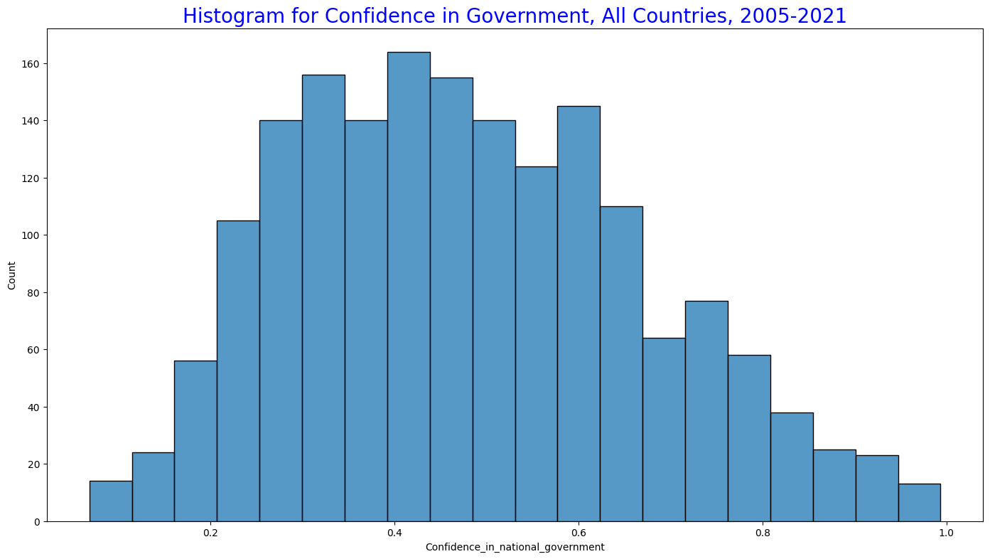
Histogram
Two factors that operate hand in hand
As expected, higher perceptions of corruption are related to a decrease in confidence of the national government
“Is corruption widespread throughout the government in this country or not?”
“Is corruption widespread within businesses in this country or not?”

Slide 13
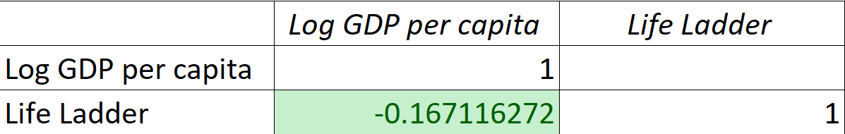
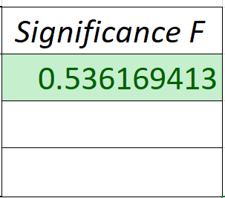
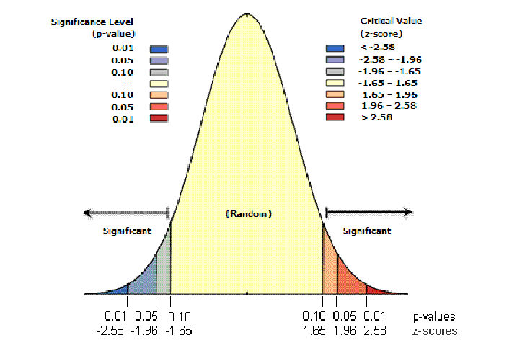
Hypothesis Testing
Hypothesis: Null Hypothesis: The Happiness Index of a country is strongly correlated with the GDP of a country in a positive linear fashion.
Null Hypothesis: The Happiness Index of a country has no correlation with the growth of GDP of a country.
This hypothesis was tested on Denmark as it averaged the highest Happiness Score.
Pearson’s Correlation Coefficient: -0.167, weak negative correlation; as growth of GDP increases, happiness decreases slightly
P-value: 0.5362, the relationship presented is statistically insignificant, the null hypothesis is accepted

Slide 14
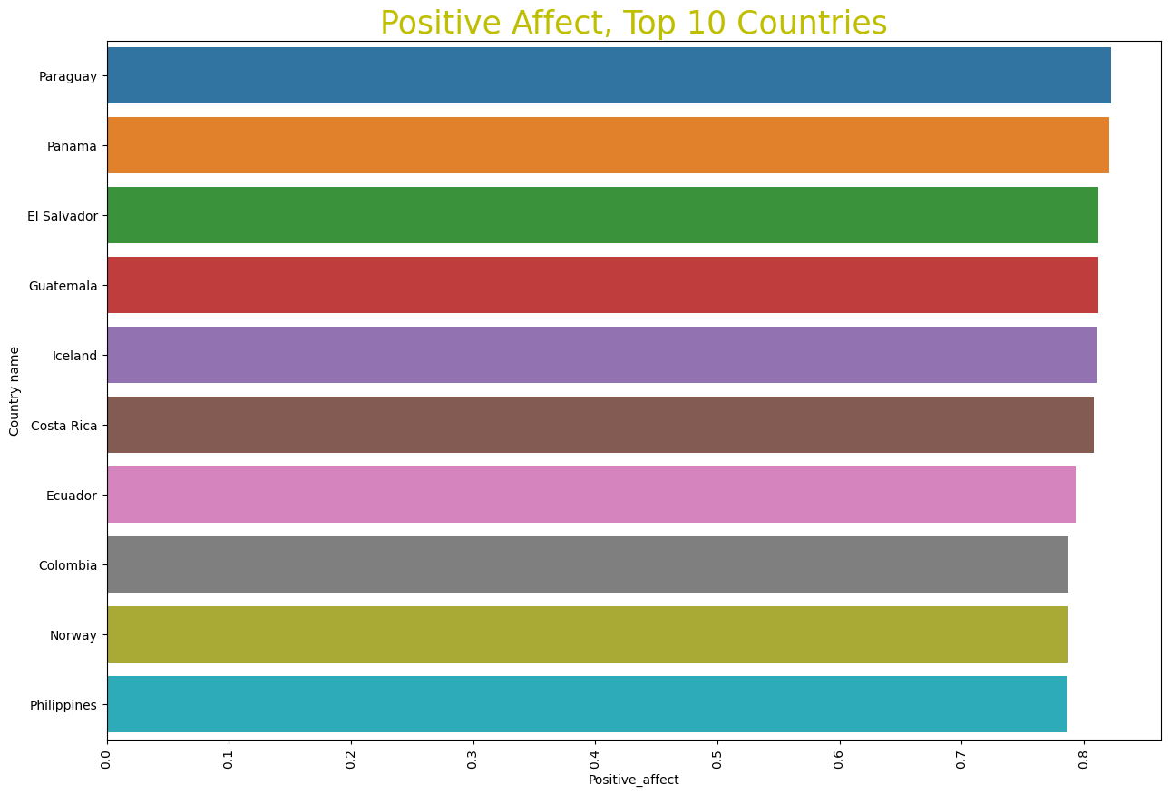
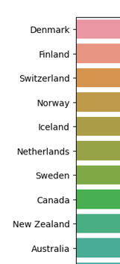
Graph of Interest
Different from Top 10 by Happiness Index
“Did you experience the following feelings during a lot of the day yesterday?” Laughter and Enjoyment.
“Did you learn or do something interesting yesterday?”
What is causing this difference?
Cultural values?
Subjective evaluation of happiness

Slide 15


Conclusion
Too many factors contribute to Happiness
Subjective in nature
Cultural values and biased surveys
Considered to be a fun study and not taken seriously
Q & A

